Slide 1
Lab3 CUDA Basic
Nov, 2022 Parallel Programming

Slide 2
Overview
Platform guide
Hades
NCHC Container
Tools
Assignment

Slide 3
Platform Guide (Hades)

Slide 4
GPU Cluster
Host: hades.cs.nthu.edu.tw
Account: same as apollo
Password: same as apollo

Slide 5
GPU Cluster
ssh
hades01
CPU
Node
hades02
1080*2
hades03
1080*2
hades04
1080*2
hades05
1080*2
hades06
1080*2
hades07
1080*2
slurm

Slide 6
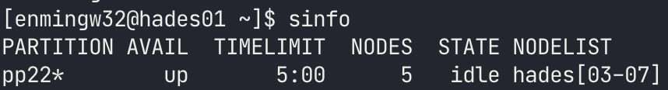
Job Scheduler
SLURM
Course partition: pp22
Limitation
2 gpus
5 minutes

Slide 7
Access Resource
hades02
ssh hades02
If you want to specify which GPU to use.
export CUDA_VISIBLE_DEVICES=<gpu id>
eg. export CUDA_VISIBLE_DEVICES=1
eg. export CUDA_VISIBLE_DEVICES=0,1
hades[03-07]
Slurm
Access gpus with flag --gres=gpu:<number of gpu>
eg. srun -n 1 --gres=gpu:1 ./executable
eg. srun -n 1 --gres=gpu:2 ./executable
Two GPUs will be executed on the same node.

Slide 8
Platform Guide (NCHC CT)

Slide 9
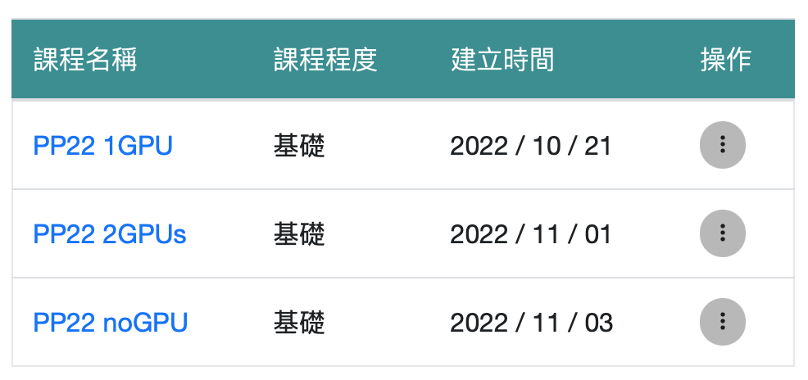
NCHC Container
Webpage: https://portal.apps.edu-cloud.nchc.org.tw
Tutorial: https://hackmd.io/@enmingw32/pp22-nchc
Register your account first
GPU: RTX 3070
Total available GPUs: 28
Please stop your container if you aren’t using it

Slide 10
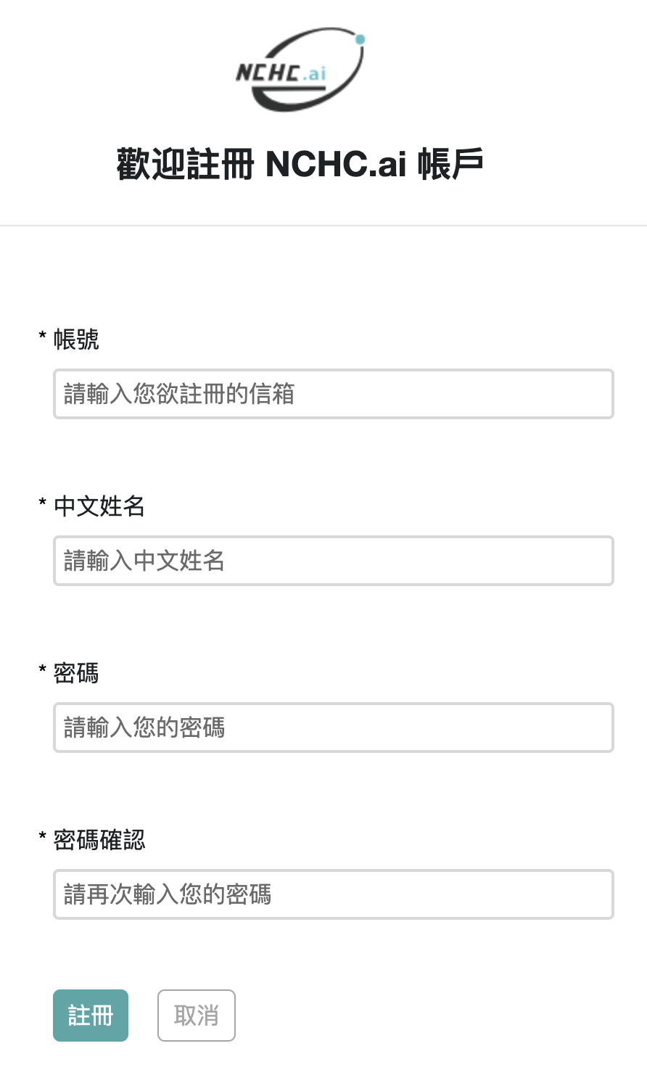

Register
1
Your gmail in this sheet
Enter whatever you want
2

Slide 11
Login

Slide 12
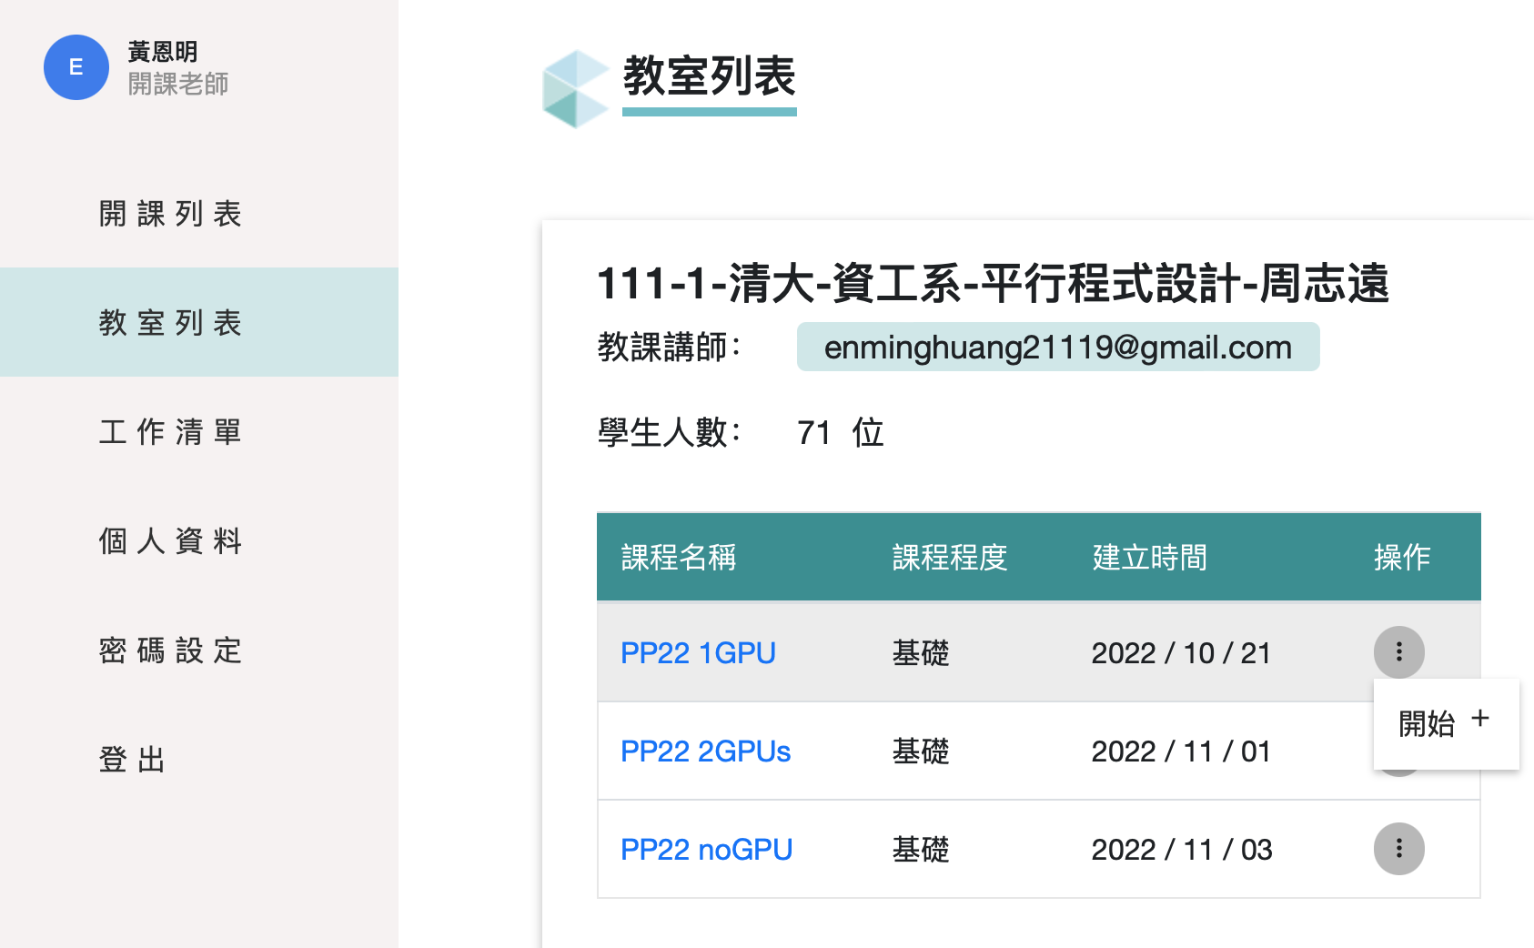
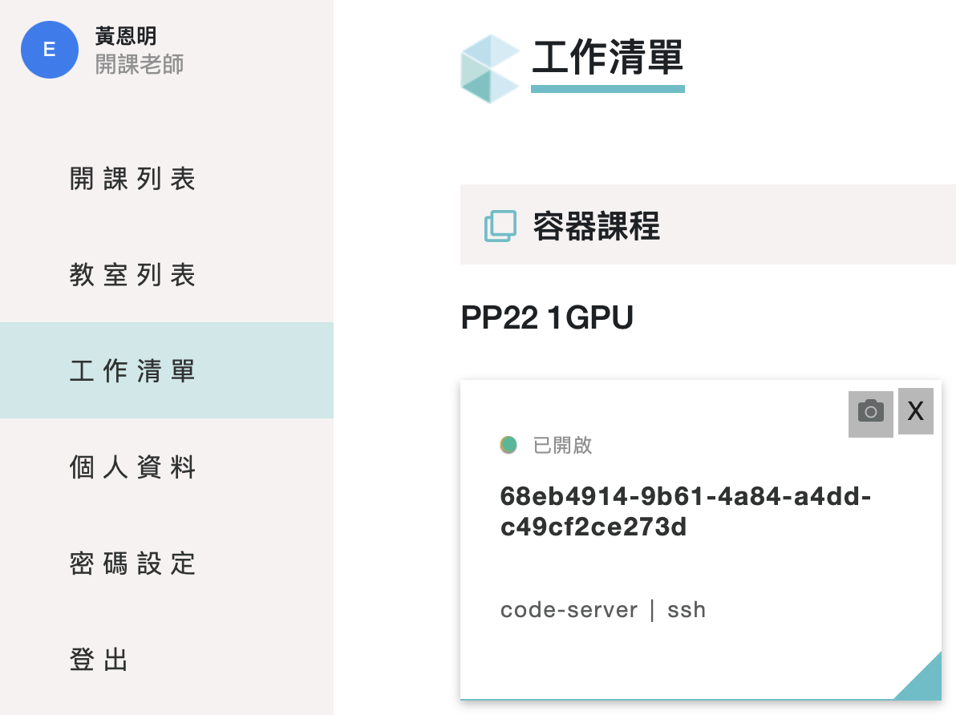
Start Container
1
3
2

Slide 13
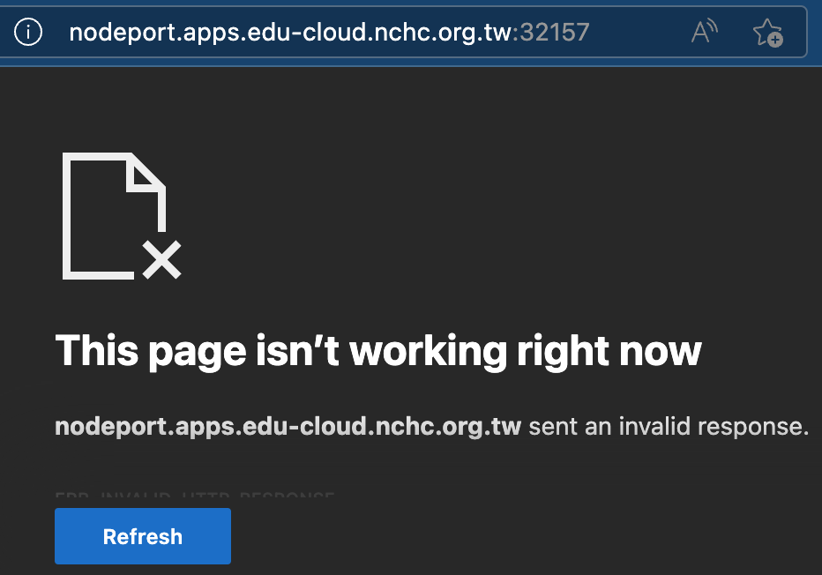
Access the Container
SSH
The port number will be different
Codeserver (the web version of vscode)
Click the “code-server” button
MobaXterm or Terminal:
ssh root@nodeport.apps.edu-cloud.nchc.org.tw -p 32157

Slide 14
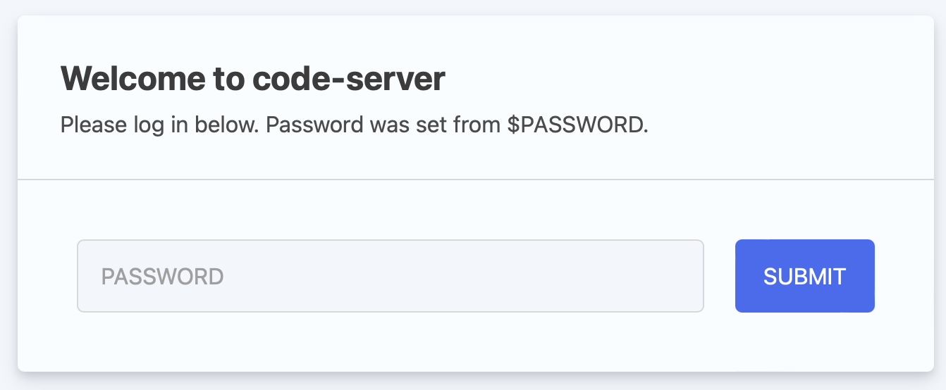
User & Password
User: root
Password: student
The password of ssh and code-server is the same

Slide 15
First-time Setup Script
Open terminal in the container:
bash <(curl -s https://apollo.cs.nthu.edu.tw/pp22/setup-remote.sh)
The script will execute the following commands:
Set proper bash config for homework and lab judger (e.g., hw3-2-judge)
Generate ssh key and install it on Apollo (you will be prompted to enter your Apollo account name and password)
Run this script only once, even you relaunched your container (since your personal data will be kept).

Slide 16
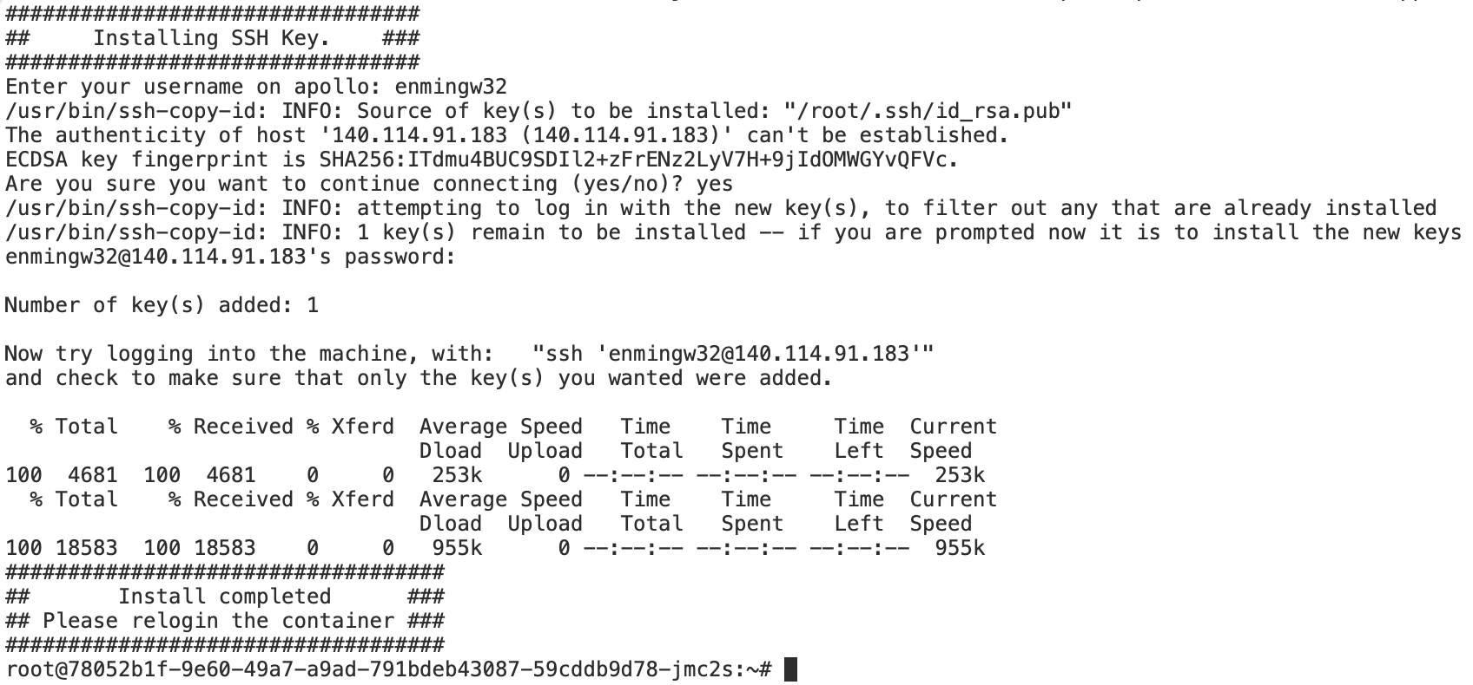

Slide 17
Stop your container
Please stop your container if you aren’t using it; otherwise, other students may not have enough GPU resources
Your files located under $HOME (/root/) will be preserved

Slide 18
NO MINING
Educational use only
Please cherish the computing resources we provided

Slide 19
Compile & run
Compiler nvcc
nvcc [options] <inputfile>
eg. nvcc cuda_code.cu -o cuda_executable
Run
Refer to the previous slide
Notes:
強調一下 檔名是.cu

Slide 20
Practice
In this practice, you can try to run the deviceQuery on
hades02 or NCHC container
scheduler
Compile
cp -r /home/pp22/share/lab3/deviceQuery $HOME
cp -r /tmp/pp22-dataset/pp22/share/lab3/deviceQuery $HOME
cd $HOME/deviceQuery
nvcc deviceQuery.cpp -o deviceQuery
Run it on
hades02 or NCHC container
scheduler (via srun)
How many CUDA cores on GTX1080 ?
Hades
NCHC

Slide 21
Tools

Slide 22
nvidia-smi
NVIDIA System Management Interface program
You can query details about
gpu type
gpu utilization
memory usage
temperature
clock rate
...

Slide 23
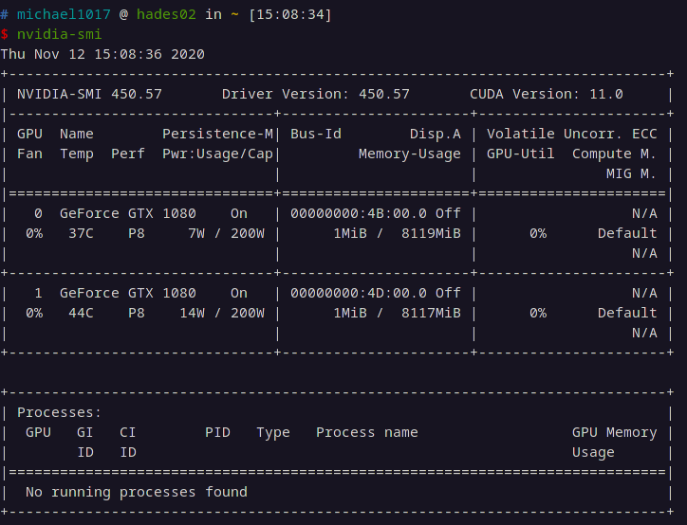
nvidia-smi example

Slide 24
cuda-memcheck
This tool checks memory errors of your program, and it also reports hardware exceptions encountered by the GPU. These errors may not cause program to crash, but they could result in unexpected program behavior and memory misusage.
Useful for debugging
Error types
cuda-memcheck

Slide 25
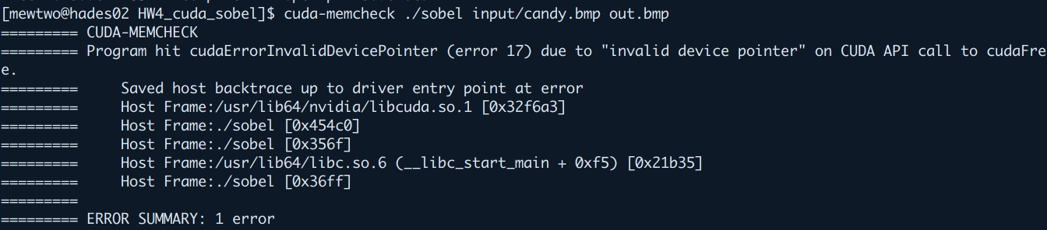
cuda-memcheck

Slide 26
cuda-gdb
cuda-gdb tutorial

Slide 27
nvprof & nsight-compute
A CUDA profiler provides feedback to optimize CUDA programs
nvprof ./lab3 in.png out.png
-o <FILE> to save result to a file
-i <FILE> to read result from a file
GTX 1080: nvprof
RTX 3070: nsight-compute (command: ncu)

Slide 28
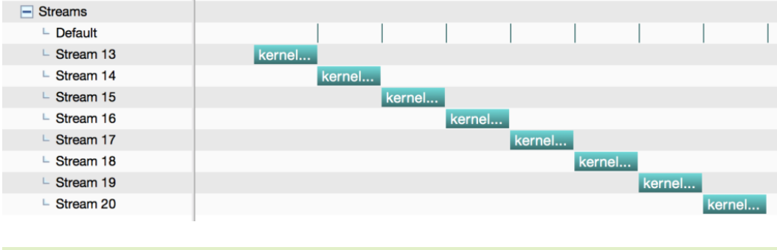
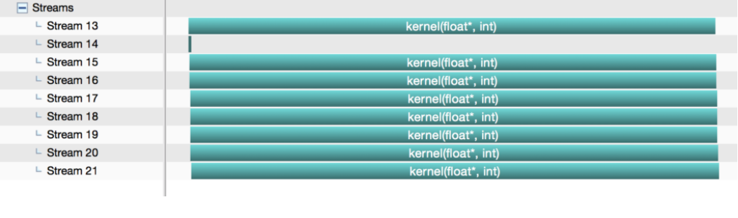
nvvp
nvvp-tutorial
GUI version of nvprof
Useful for the stream optimization
Timeline
nvvp is useful for checking the concurrency of stream

Slide 29
Lab3 Assignment

Slide 30

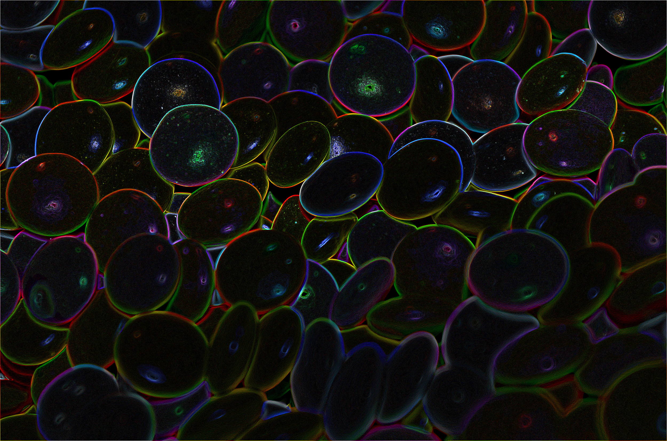
Problem Description
Edge Detection: Identifying points in a digital image at which the image brightness changes sharply

Slide 31
Sobel Operator
Used in image processing and computer vision, particularly within edge detection algorithms.
Uses two 3x3 kernels gx, gy which are convolved with the original image to calculate approximations of the derivatives - one for horizontal changes, and one for vertical.

Slide 32
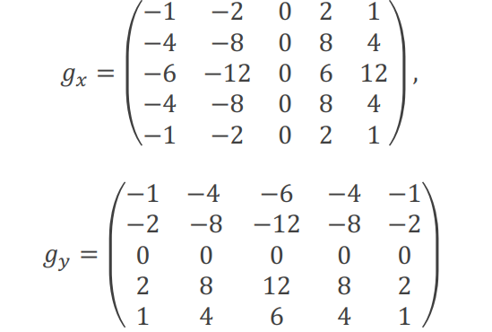
5x5 Variation
We use this kernel instead of the 3x3 one in this lab

Slide 33
Convolution Calculation
Iterate through the width and height of the image
For each pixel, multiply the filter matrix with original image element-wisely and sum them up.
 |  | p0

Slide 34
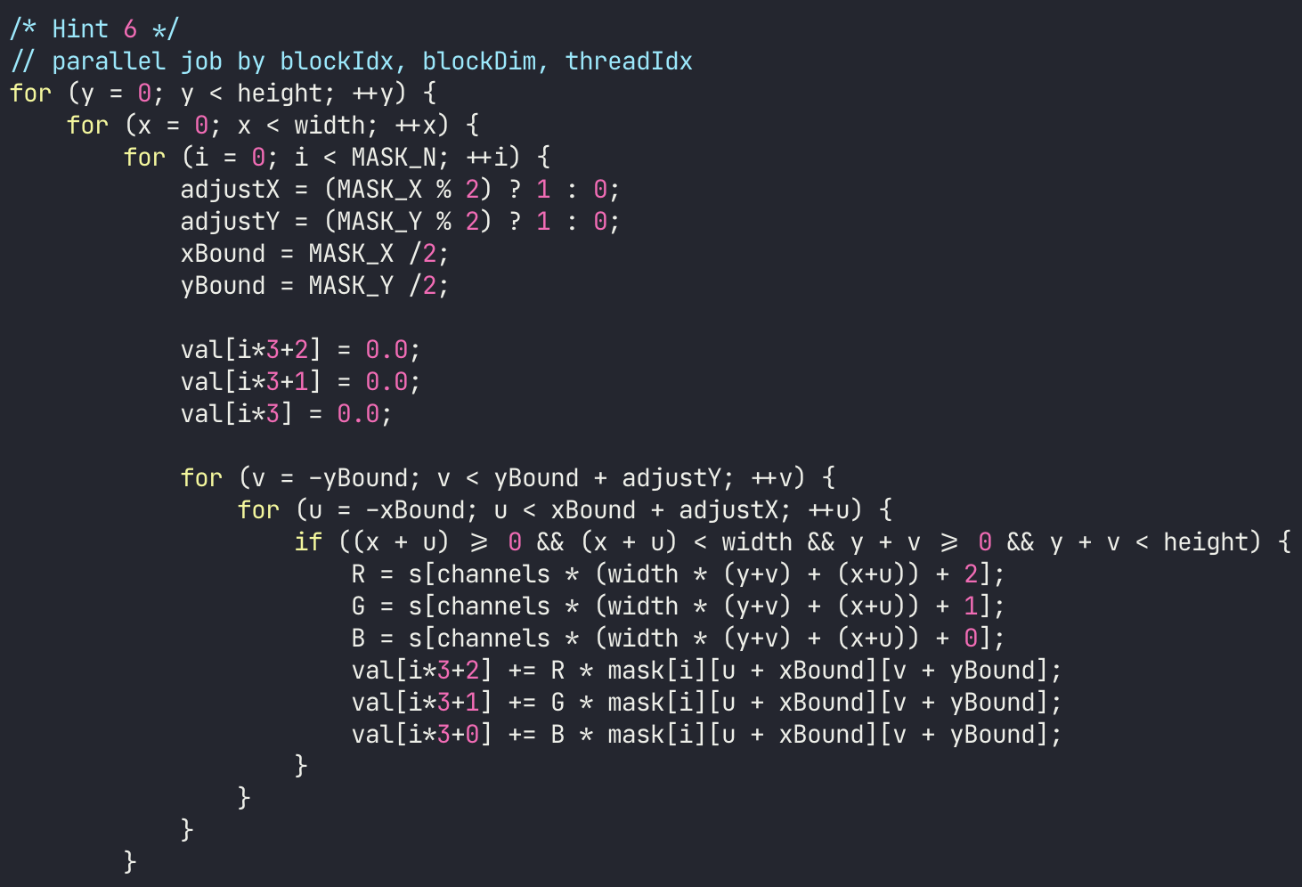
Hints
Refer to sample code

Slide 35
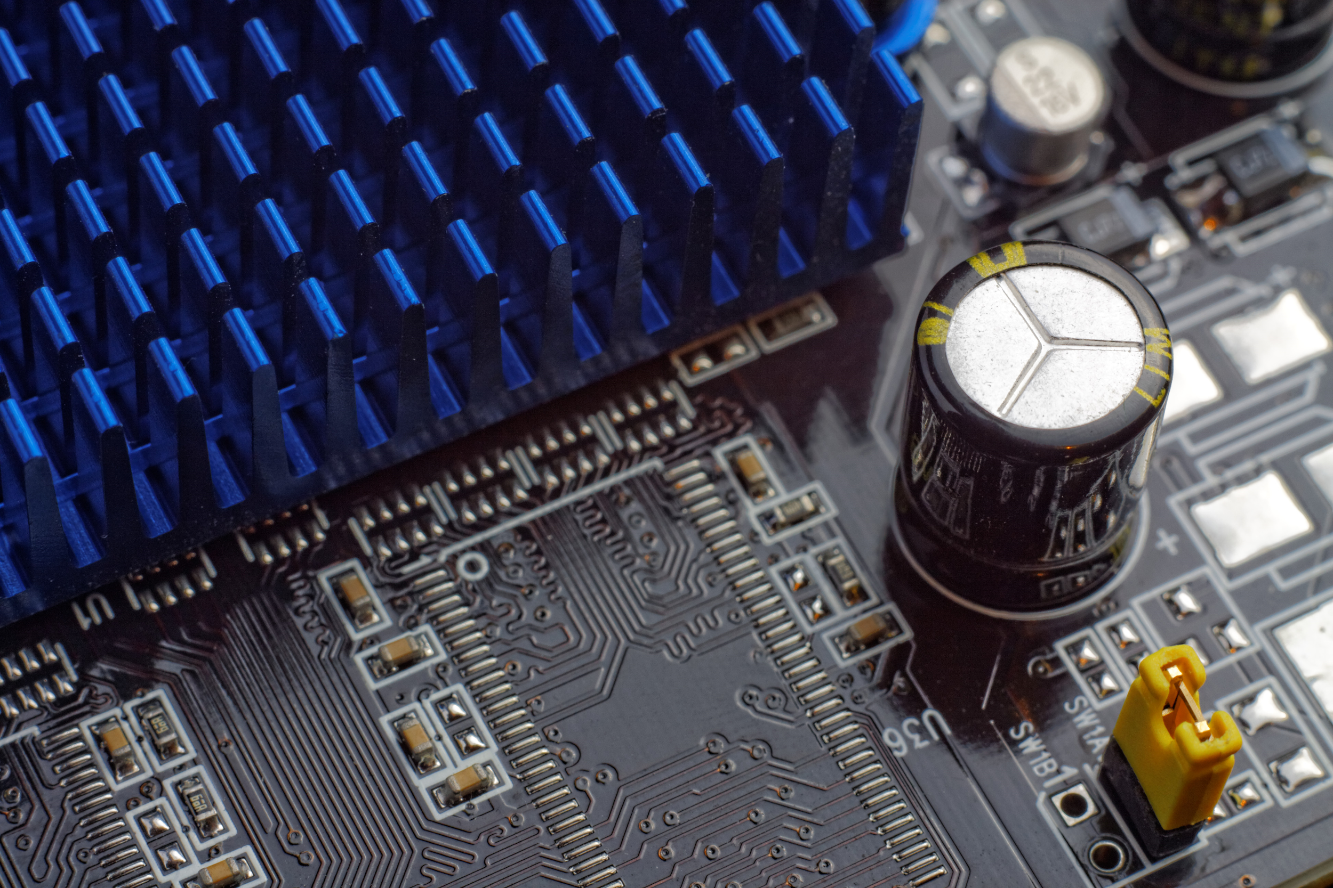
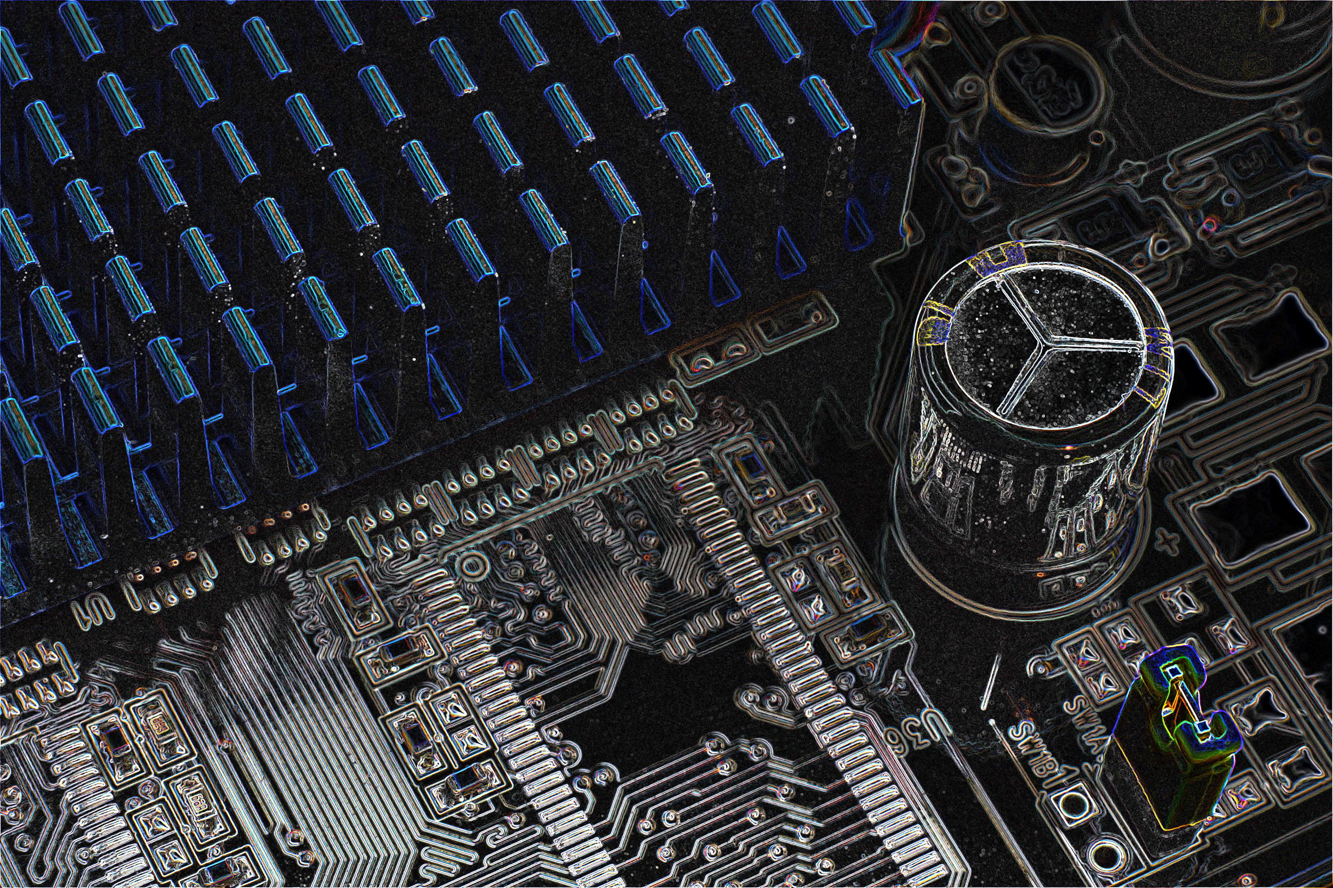
Sample Result

Slide 36
Preparation
TA provides CPU version, Makefile, and hint
File is located at /home/pp22/share/lab3
Please do NOT copy the testcases.
lab3.cu is cpu version (you need to rewrite it with cuda!)
You can follow hints to write

Slide 37
How to run
hades02 & NCHC
./lab3 <input> <output>
CUDA_VISIBLE_DEVICES=0 ./lab3 <input> <output>
hades[03-07]
srun -n 1 ./lab3 <input> <output>
srun -n 1 --gres=gpu:1 ./lab3 <input> <output>
Compare your result with the answer
png-diff <output image> <answer image>

Slide 38
Hints
Malloc memory on GPU
Copy original image to GPU
Put filter matrix on device memory (or declare it on device)
Copy filter matrix to shared memory (don’t let only one thread do it)
Parallelize the sobel computing
Copy the results from device to host
Free unused address

Slide 39
Submission
judge will execute your code with single process, single GPU
submit your code and Makefile (optional) to eeclass before 11/17 23:59
use lab3-judge
We support lab3-judge, hw3-2-judge and hw3-3-judge on NCHC, but the final result is based on Hades.
Try to write your code on NCHC, and perform fine tune on Hades to avoid heavy queueing delay.

